Slide 1
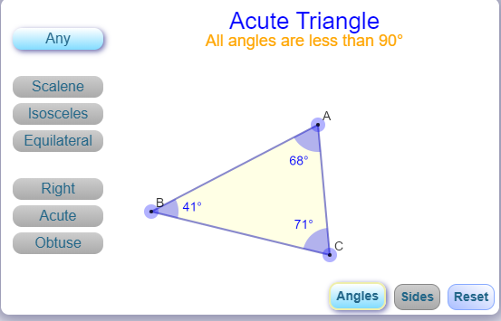
DRAWING TOOLS
TRIANGLE PROPERTIES
.
INFORMATION AREA. This section has to be populated with an image and definition of what is clicked
DRAWING AREA
PROPERTIES BOX
ANGLE
LENGTH
SUM OF ANGLES
RESET

Slide 2
DESIGN TEAM
BUILD A GOOD IMAGE FOR EACH OF THE MENU BUTTONS. – SEE BELOW LIST.
YOU HAVE TO CREATE MENU BUTTON AND AN IMAGE FOR DISPLAY.
CLICK ON A BUTTON AND CLICK IN DRAWING AREA. IT SHOULD DRAW THE CORRESPONDING OBJECT.
OBJECTS NEEDED
DRAWING TOOLS
RULER,
PROTRACTOR
LINE
LEFT HAND MENU ITEMS
EQUILATERAL TRIANGLE
ISOCLES TRIANGLE
RIGHT ANGLE TRIANGLE
[NOTE – SHOW ANGLE VALUES IN THE TRIANGLE]
SCALENE TRIANGLE
---------------
CENTROID
ANGLE SUM PROPERTY
EXTERIOR ANGLE PROPERTY
PROGRAMMING NOTES:
CLICK ON A BUTTON AND CLICK IN DRAWING AREA.
CORRESPONDING TRIANGLE SHOULD BE SHOWN IN DRAWING AREA.
INFORMATION AREA – NEEDS A DESCRIPTION OF THAT TRIANGLE
DRAWING AREA –
NEEDS THE INTERACTIVE TRIANGLES BUILT BY VENKAT. CAN PARAM GEOMETRY LAYOUT AND VENKAT’S INTERACTIVE TRIANGLES WORK ON THE SAME DIV?
CENTROID, ANGLE SUM PROPERTY, EXTERIOR ANGLE PROPERTY WILL BE DONE USING THE GEOMETRY LAYOUT BUILT BY PARAM
TEACHING GUIDE – WILL NEED DEFINITIONS FOR EACH ITEM AND EXPLANATION ABOUT THE VARIOUS MENU OPTIONS

